Slide 1
Meeting Simon
2023-09-21

Slide 2
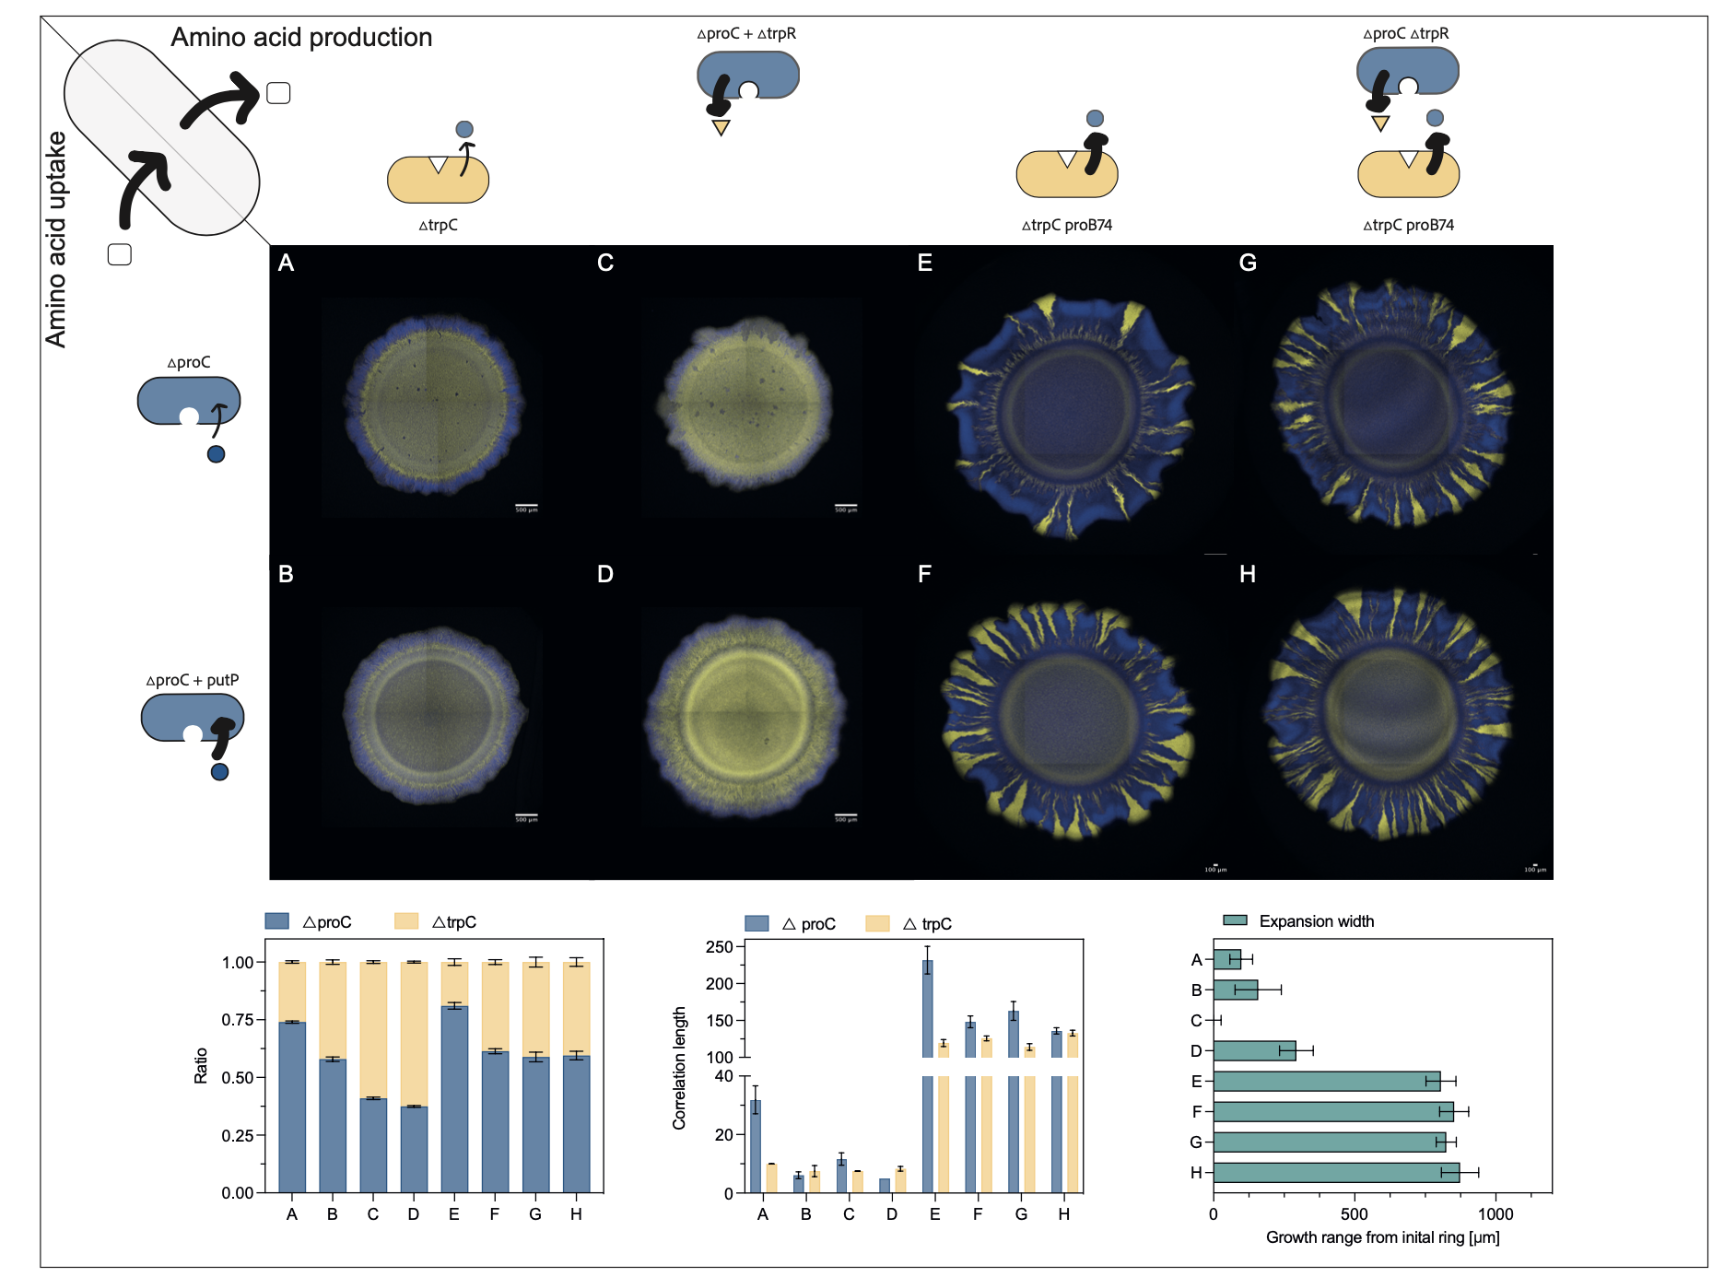

Slide 3
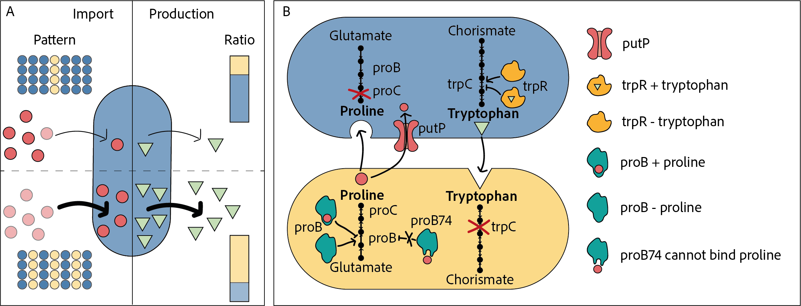

Slide 4
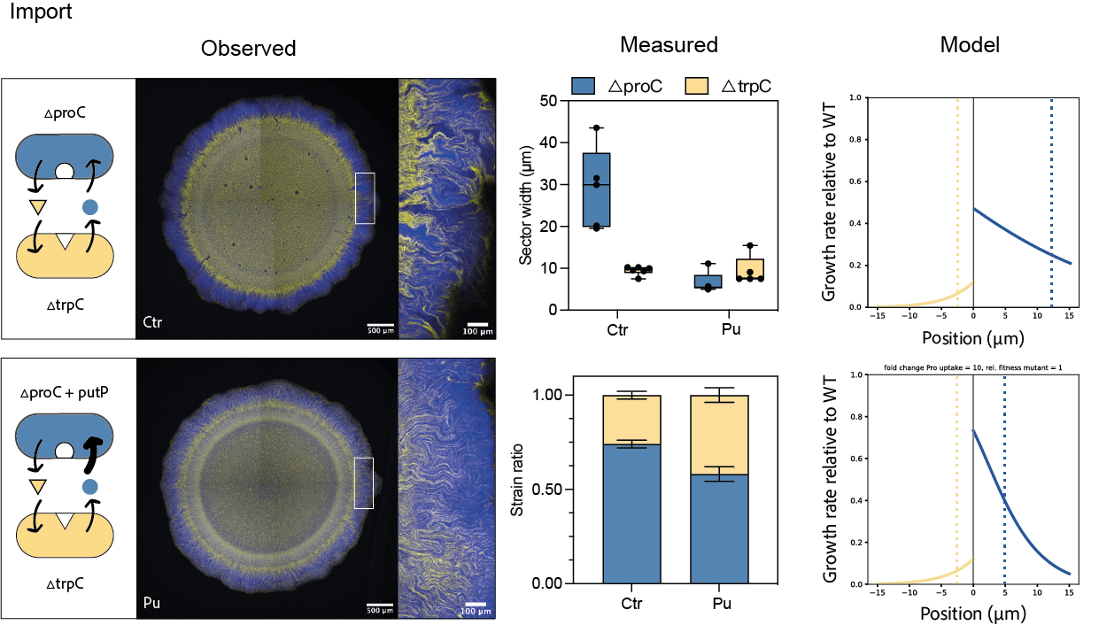
A
B

Slide 5
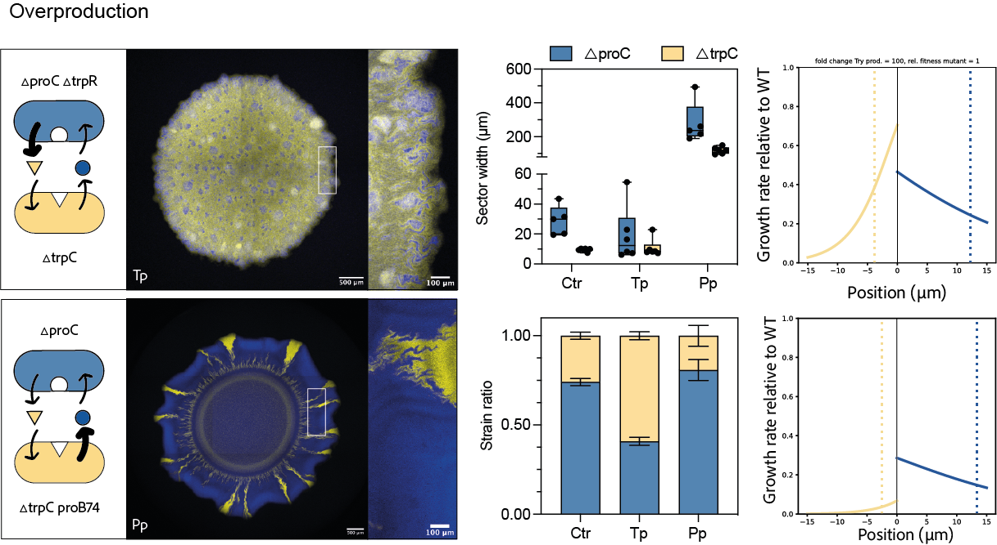
C
E

Slide 6
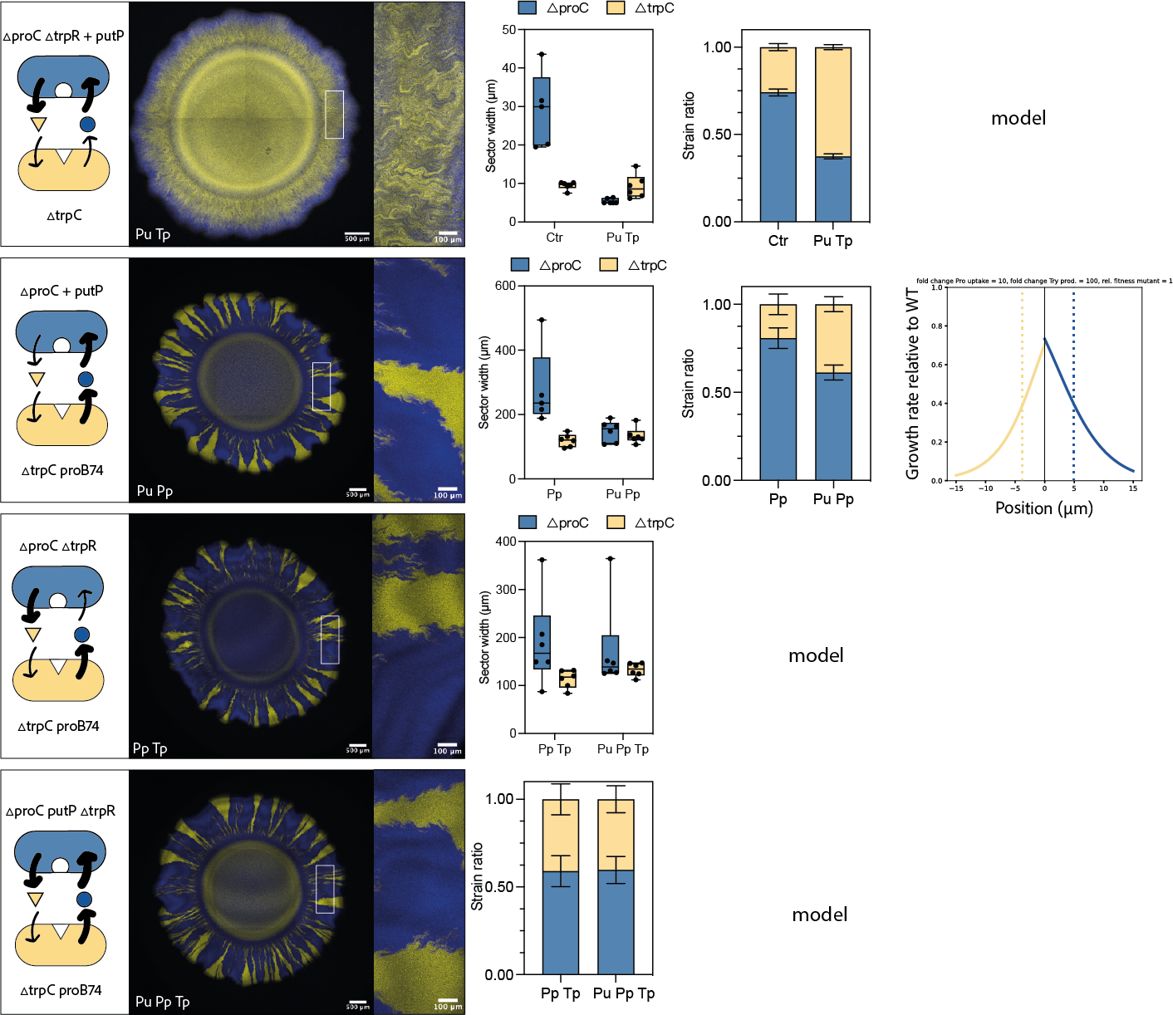
Combinations
D
F
G
H

Slide 7
Expansion width, a proxy for growth rate?

